Slide 1

Instagram User Analytics
Presented By: Rakhi kumari

Slide 2
Contents
Project description
Objectives
Approach
Methodology and software used
Schema
Insights
Key findings
Achievements

Slide 3

Project description
A data analyst plays a huge role in business optimization of any organization, in this project I have answered some important queries related to user engagement, marketing and investor metrics with the help of a given dataset that was used to dig deep into the factors that can have help improving the business and give insights to build further modification.

Slide 4

Approach
I have used relational database software to inspect and answer queries I was asked , gathered the information and loopholes and jotted them down.

Slide 5
Methodology and software used
My SQL version 8.0 was used in this project.
The MySQL workbench is used to write and execute queries.
The entire data analysis was done on the given Instagram database.
A number of SQL functions and queries are used in this project.
After jotting down the required insights , Microsoft Powerpoint was used to present the project.

Slide 6
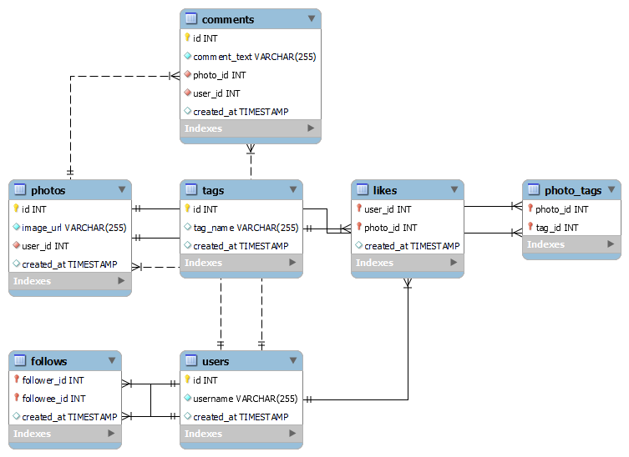
Schema

Slide 7
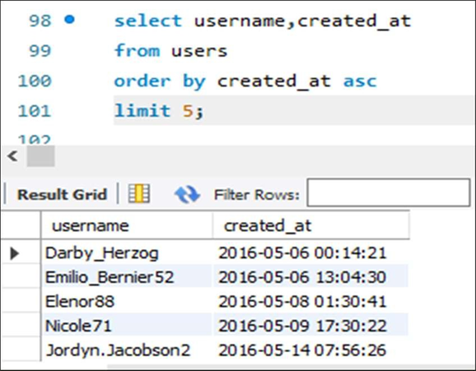
Insights: Marketing
Query 1: Rewarding Most Loyal Users.
TASK: Find the 5 oldest users of the Instagram from the database provided.
CODE USED : select username, created_at
from users order by created at asc
limit 5;

Slide 8
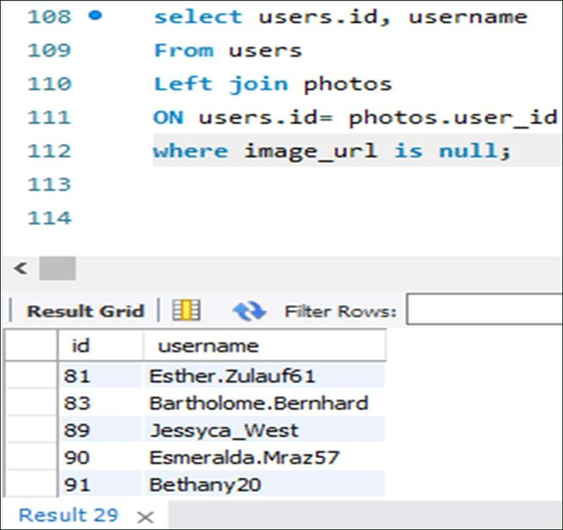
Insights: Marketing
Query 2: Remind Inactive Users to Start Posting.
TASK: Find the users who have never posted a single photo on Instagram.
CODE USED : select users.id, username
from users left join photos
on users.id= photos.user_id
Where image_url is null;

Slide 9
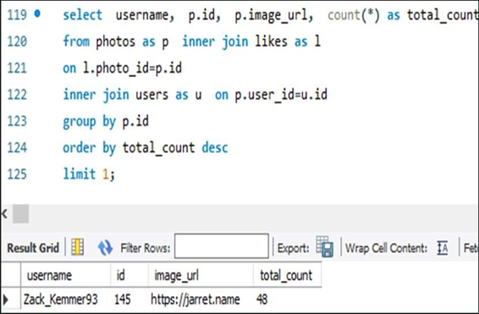
Insights: Marketing
Query 3: Declaring Contest Winner.
TASK: Identify the winner of the contest and provide their details to the team.
CODE USED : select username, p.id, p.image_url, count(*) as total_count
from photos as p join likes as l
on l.photo_id=p.id
join users as u
on p.user_id=u.id
group by p.id
order by total_count desc
limit 1;

Slide 10
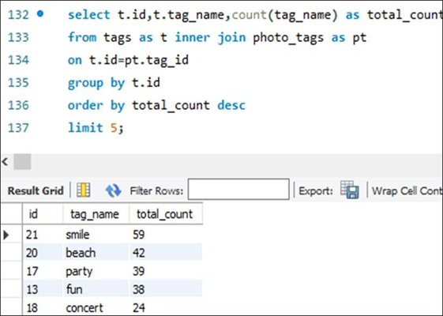
Insights: Marketing
Query 4: Hashtag Researching.
TASK: Identify and suggest the top 5 most commonly used hashtags on the platform.
CODE USED : select t.id, t.tag_name, count(tag_name) as total_count
from tags as t inner join photo_tags as pt
on t.id=pt.tag_id
group by t.id
order by total_count desc
limit 5;

Slide 11
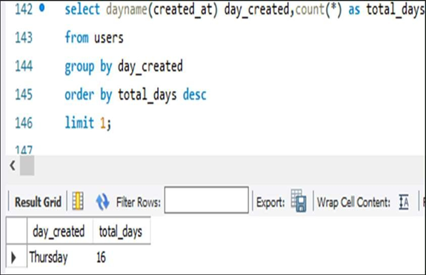
Insights: Marketing
Query 5: Launch AD Campaign.
TASK: What day of the week do most users register on? Provide insights on when to schedule an ad campaign
CODE USED: select dayname(created_at) day_created, count(*) as total_days
from users
group by day_created
order by total_days desc
limit 1;

Slide 12
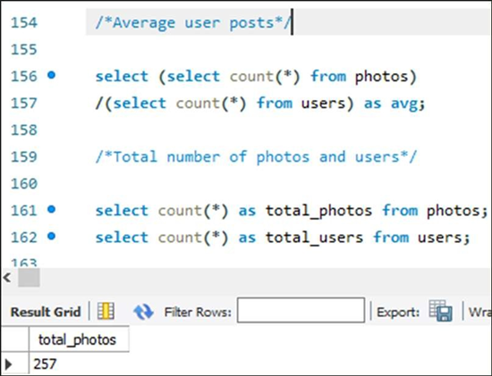
Insights: Marketing
Query 1: User Engagement.
TASK: Provide how many times does average user posts on Instagram. Also, provide the total number of photos on Instagram/total number of users
CODE USED: 1. select (select count(*) from photos) / (select count(*) from users) as avg;
2. select count(*) as total_photos from photos; select count(*) as total_users from users

Slide 13
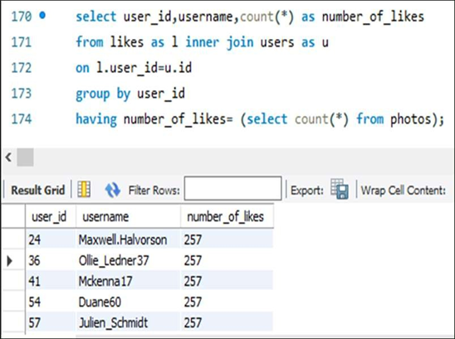
Insights: Investor Metrics
Query 2: Bots and Fake Accounts.
TASK: Provide data on users (bots) who have liked every single photo on the site (since any normal user would not be able to do this).
CODE USED: select user_id, username, count(*) as number_of_likes from likes as l inner join users as u
on l.user_id=u.id
group by user_id
having number_of_likes= (select count(*) from photos

Slide 14
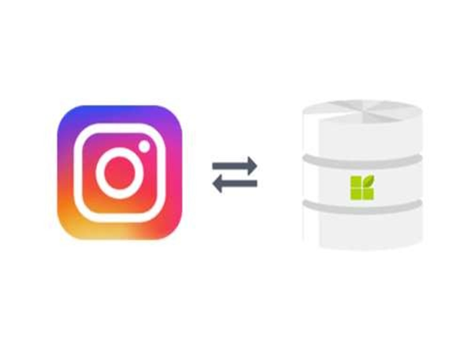
Darby_Herzog,Emilio_Bernier52,Elenor88,Nicole71,Jordyn.Jac obson2 are the top 5 oldest users.
There are total 26 users who has never posted a single photo.
Zack_Kemmer93 is the winner of the contest with the highest likes,48.
smile, beach, party, fun and concert are the top five most commonly used hashtags.
In a week, most users register on Thursday.
An average user posts on instagram 2.57 times and the total number of users and photos in instagram are 100 and 257.
There are total number of 13 fake/bot accounts that like on every single picture in instagram.
Key Findings

Slide 15
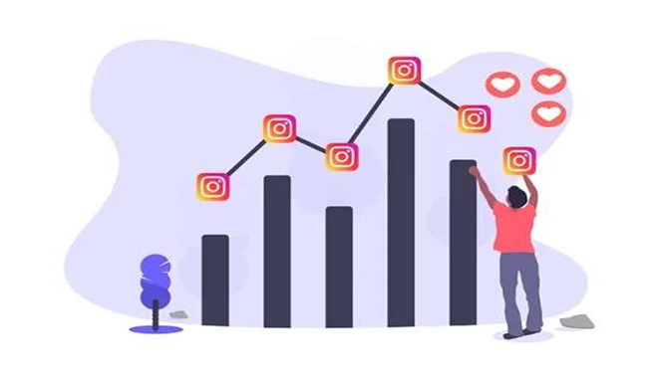
Achievements
Data cleaning: This entire project has helped me
learning the approaches to convert raw data into clean data.
Practical knowledge: Experienced a practical exposure with different SQL commands and their uses in real life
industries.
Business optimization methods: Gained an idea on how the industries and organizations optimize their
business problems and queries and learned the strategic approaches that helps in the growth of an industry.

Slide 16


